Slide 1

The Impact of Health Expenditure and Food Security on Life Expectancy
ECO 4421 Results:
By Ethan Bohm, Gerhard Matamoros, Jeffrey Sims
10/23/2023
Notes:
(Gerhard) Our project is based on the impact that health expenditure and food security have on a country’s life expectancy

Slide 2
Introduction
The United States ranks 13th place out of 113 countries in overall food safety and security (Using GFSI)
How does a country’s food safety and health spending impact their average life expectancy?
Could people live longer in countries with better food and health policies?
Notes:
(Gerhard) Last year we saw the largest year over year increase in CPI since the 1980’s. Our research question concerns how such high inflation affect americans on a day to day basis.

Slide 3
Data and Variables
Datasets: GFSI.csv (Global Food Security Index per country), health_expenditure.csv (Healthcare goods and services consumed per household))
Explanatory variables: health expenditure per capita, GFSI
Dependent variable: average life expectancy
Data Origins: Economist Impact, UN Department of Economic and Social Affairs (Population Division)
Notes:
(Jeff)

Slide 4
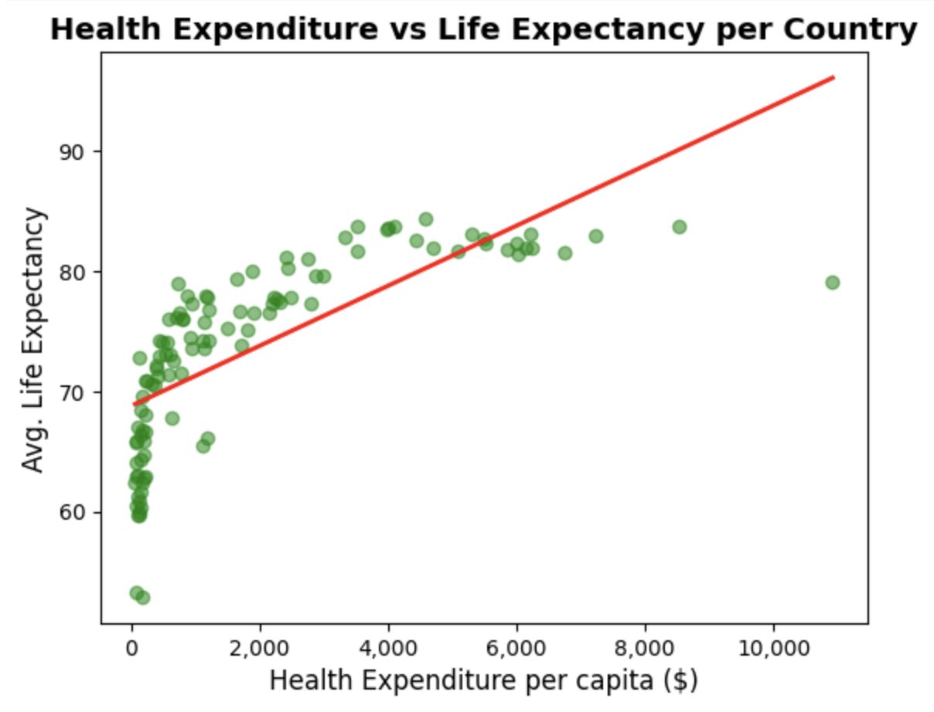
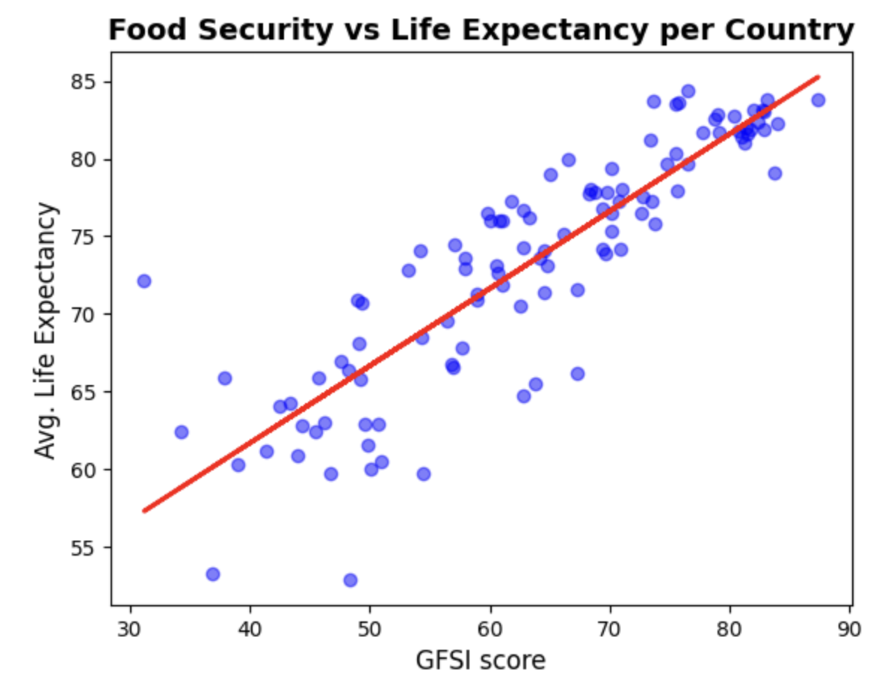
Regression Results
Life Expectancy = 0.003 + 0.085(Health Exp.) + 0.784(GFSI) + μ
R² = 0.522
R² = 0.759
Combined R² = 0.872
Notes:
(Ethan) Our multiple linear regression equation is as follows: Life expectancy in years is equal to 0.003 + 0.085 times the health expenditure per capita + 0.784 times the GFSI + an error term. We can see that health expenditure has an r squared of 0.52 when compared to life expectancy and GFSI has an r squared of 0.75 compared to life expectancy. These explanatory variables combined have an r squared of 0.87, displaying a very strong linear relationship.

Slide 5
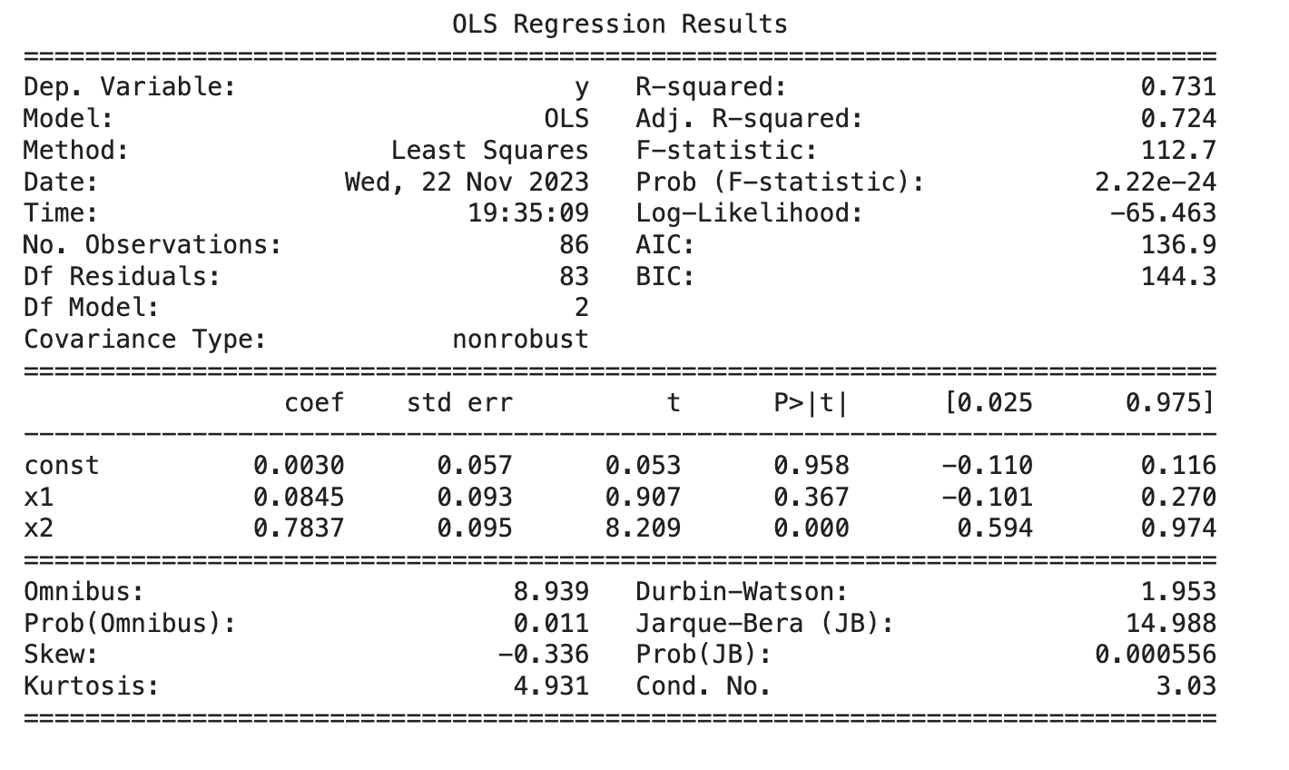


Regression Results
X1: health expenditure has a significant impact on a country’s life expectancy
X2: GFSI has a significant positive impact on a country’s life expectancy
Notes:
(Ethan)

Slide 6
Discussion
Strong evidence that food security (GFSI) in a given country affects life expectancy
Little to no evidence that health spending in a given country impacts life expectancy
People living in countries with higher GFSI will live longer (on average)
Countries should prioritize food safety as it plays a key role in life expectancy
Notes:
(Jeff) As we can see there is strong statistical evidence that Food Security (GFSI) in a given country affects Life Expectancy. Generally speaking, the average person in a country with superb food security will have a longer lifespan

Slide 7
Limitations
Only used data on 108 out of 195 countries in the world
Use data from 2019, instead of 2023
Total R² of 0.872, indicating other variables not included affect life expectancy

Slide 8
Q&A

